Slide 1
Regression and regularization

Slide 2
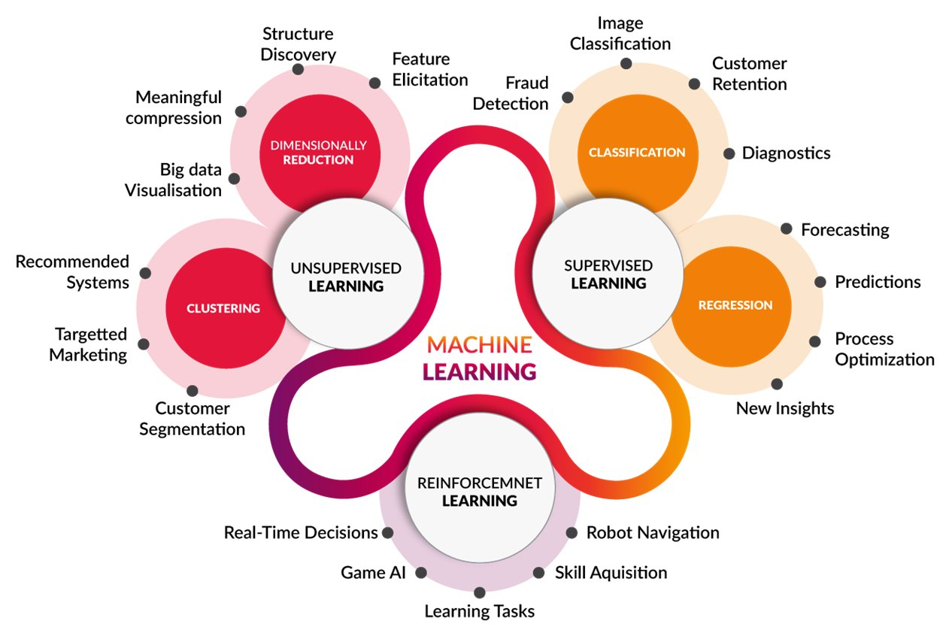


Slide 3
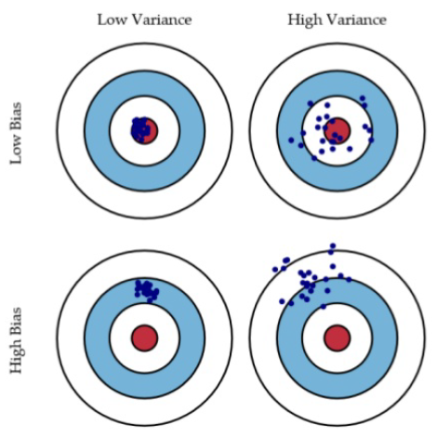
Bias vs variance

